Slide 1

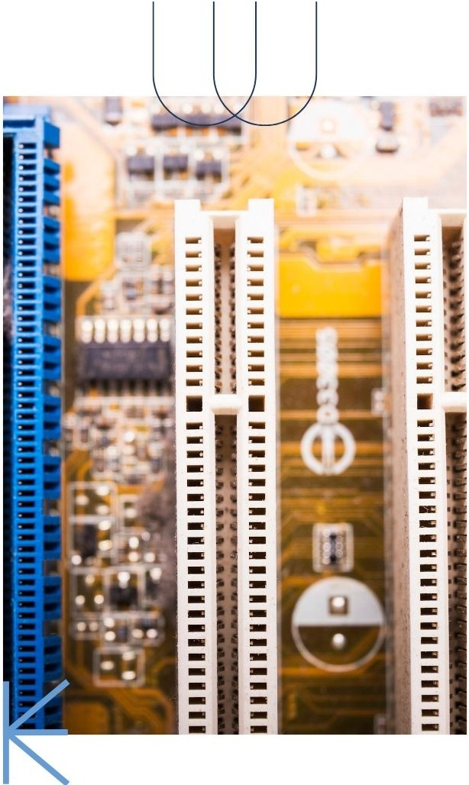



U.V. Patel collage of engineering
••••
Topic:- Basic of Microcontrollers
Enrollment number:- T24012011137
Made by:- Krish P. Thakore
Subject :- Seminar (2HS1102)

Slide 2


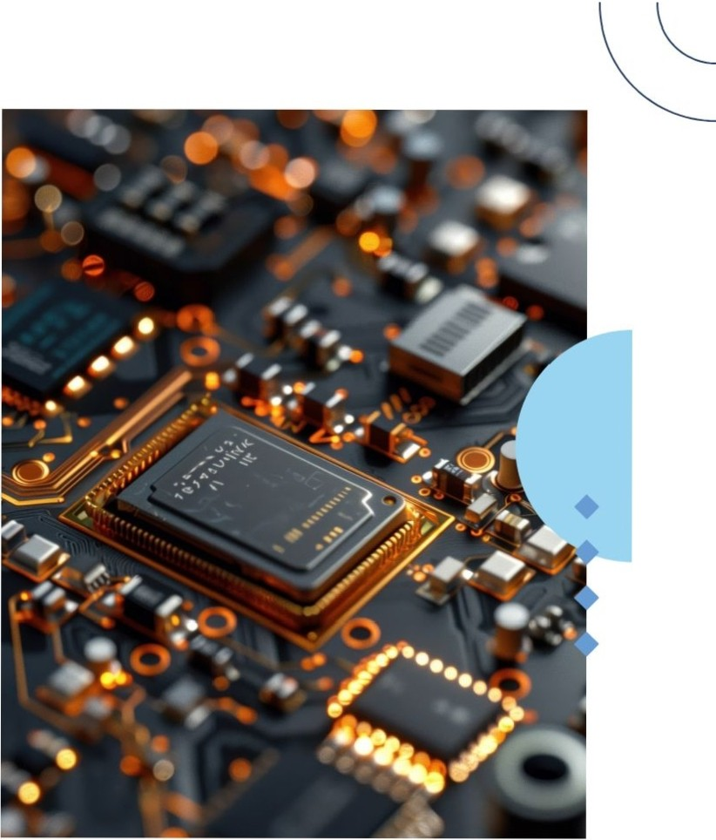


Introduction to Microcontrollers
This presentation provides a comprehensive guide to microcontrollers. We willexplore their architecture, applications, and importance in modern technology. Understanding microcontrollers is crucial for college students pursuing careers in engineering, computer science, and embedded systems.

Slide 3


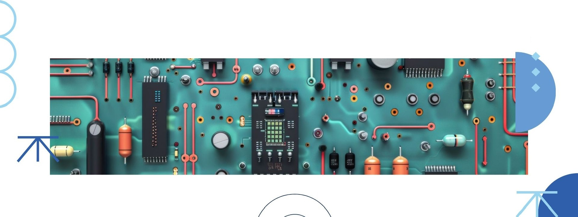
What is a Microcontroller?
A microcontroller is a compact integrated circuit designed to govern a specific operation in an embedded system.It typically includes a processor, memory, and input/output peripherals, making it essential for controlling devices and systems.
•

Slide 4



Microcontroller A rchitecture
The architecture of a microcontroller consists of various components such as the CPU, RAM, ROM, and 1/0 ports. Understanding this architecture helps in designing efficient applications and troubleshooting issues effectively.
••••

Slide 5

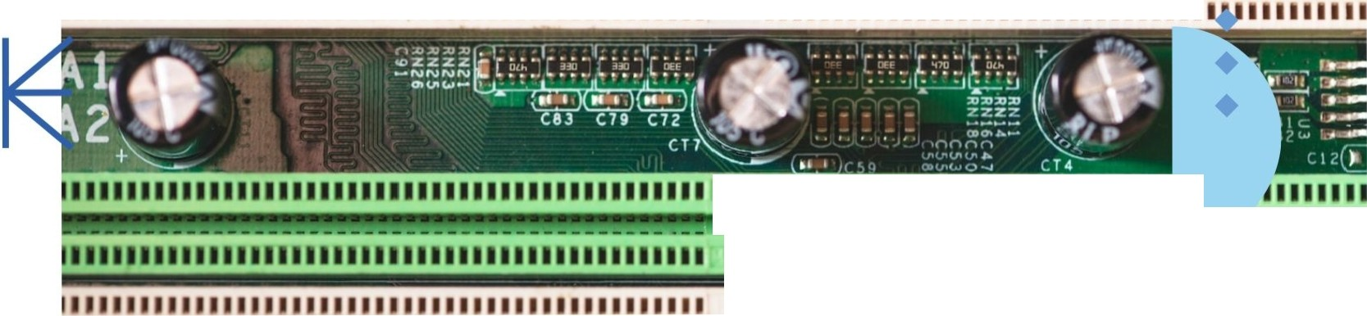



)
11111111111111111111111111111111111111111111111
•
11111111111111111111111111111111
111111111111111111111111111111
..llllllll!Rll!llll!Wllllllllll _dll...
.......................M
1111111111111111111111111111111111111111111•
JJJ llllllllllllll l lJ lllllllllllllllllll l l l l l
Types of Microcontrollers
Microcontrollers can be classified into several types, including 8-bit, 16-bit. and 32-bit microcontrollers.Each type has its own advantages and is suited for different applications based on processing power and memory requirements.

Slide 6
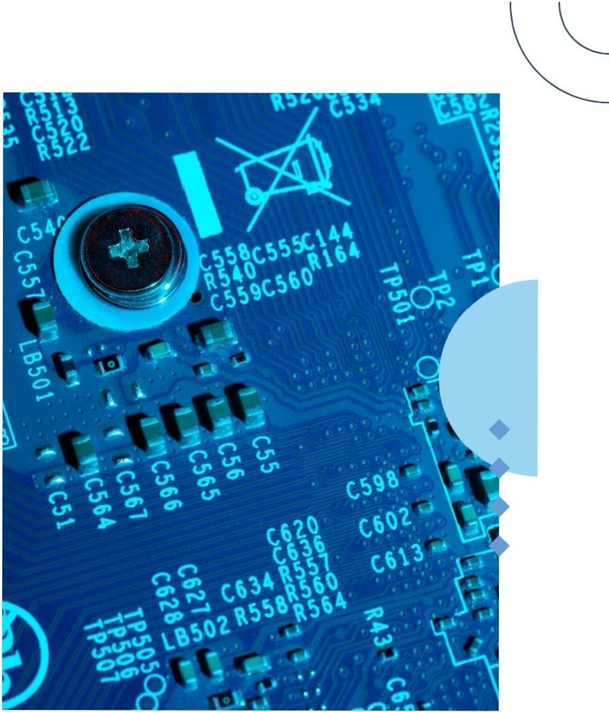

Programming Microcontroller s
Microcontrollers are programmed using languages like C,C++,and Assembly. Understanding the programming environment and tools is essential for developing applications that effectively utilize the features of microcontrollers.

Slide 7



Common Appl ications
Microcontrollers are used in a variety of applications, including automotive systems, home automation, medicaldevices,and robotics.Their versatility makes them a key component in many modern technologies.

Slide 8
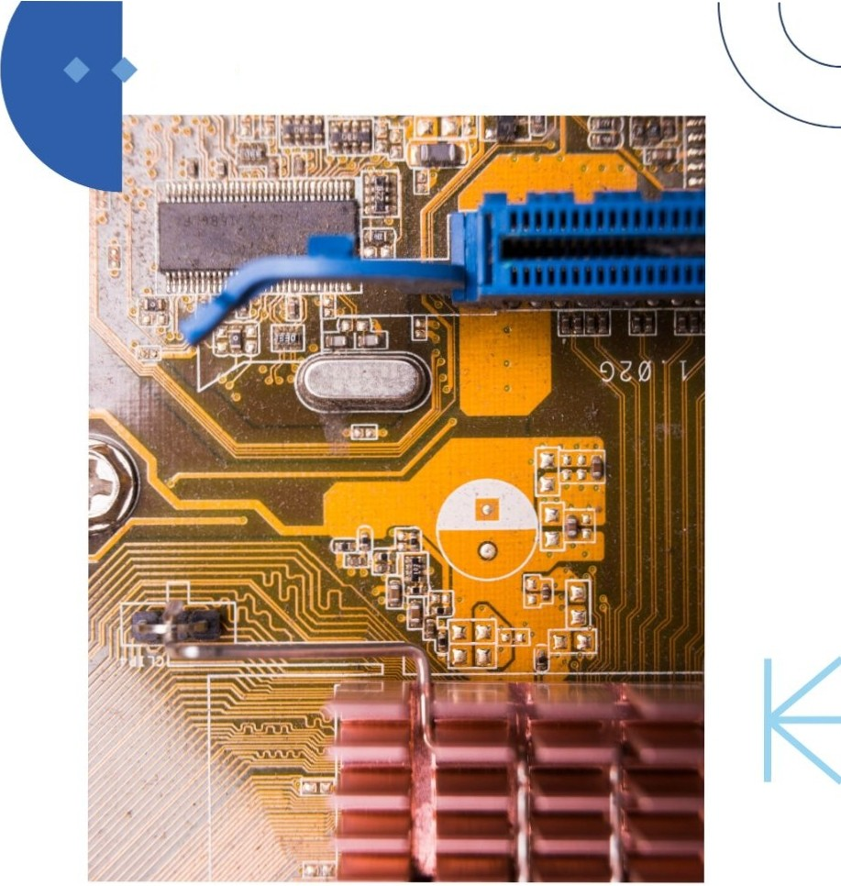


Embedded Systems Overview
••
An embedded system is a combination of hardware and software designed for a specific function.Microcontrollers play a vital role in embedded systems, enabling precise control and automation invarious industries.

Slide 9
Microcontrollers can interface with various sensors to gather data from the environment. Understanding how to connect and utilize sensors is crucial for developing intelligent systems that respond to real-world conditions.
Interfacing with Sensors
•

Slide 10

Communication Protocols
Microcontrollers use various communication protocols such as 12C, SPI, and UART to exchange data with other devices. Familiarity with these protocols is essential for effective system integration andcommunication.
••••

Slide 11
Power Management Techniques
Effective power management iscritical for microcontroller applications, especially in portable devices. Techniques such as slleep modes and voltage regulation help extend battery life and improve efficiency.

Slide 12
Challenges in Microcontroller Design
Designing with microcontrollers can pose challenges such as resource limitations, real-time constraints,and debugging issues.Understanding these challenges is essential for successful project execution and product development.
•
••

Slide 13






••
•
Conclusion and Future Trends
Inconclusion, microcontrollers are integral to modern technology. As we move towards an increasingly connected world, understanding microcontrollers will be essential for future innovations in loT, Al, and smart devices.

Slide 14








Thanks!
DO YOU HAVE ANY QUESTIONS?
youremail@freepik.com
+34 654 321432
yourwebsite .com

